Slide 1
Climate Change Effects

Slide 2
How is climate change affecting the Earth and human health?
Learning objectives
Attribution science
Effects of climate change
Heat
Precipitation
Drought
Snowfall and ice
Storms
Hurricanes
Sea level rise
Infectious diseases
Carbon sinks
To answer this question, we will:
Learn which extreme events can be attributed to climate change
Explore the effects of climate change on:
Heat
Precipitation
Drought
Snowfall and ice
Storms
Hurricanes
Sea level rise
Infectious diseases
Carbon sinks

Slide 3
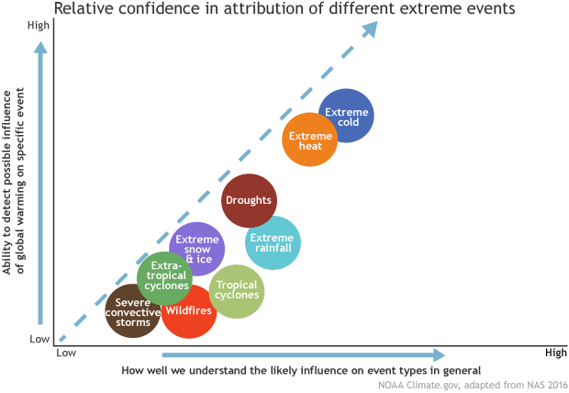
Attribution Science
Learning objectives
Attribution science
Effects of climate change
Heat
Precipitation
Drought
Snowfall and ice
Storms
Hurricanes
Sea level rise
Infectious diseases
Carbon sinks
Image copyright NOAA. https://www.climate.gov/sites/default/files/styles/full_width_620_alternate_image/public/Chart6_620.png?itok=ejHqx_Q0
Notes:
When discussing climate change, attribution science allows us to determine whether or not an extreme meteorological event is or is not caused by or made worse by global warming.
For example, there is not a strong connection between changes in severe convective storms, such as thunderstorms and tornadoes, and climate change and scientists are researching the connection between these.
On the opposite end of the spectrum, we understand very well how extreme heat and cold events are influenced by global warming and are able to detect potential influences from climate change.

Slide 4
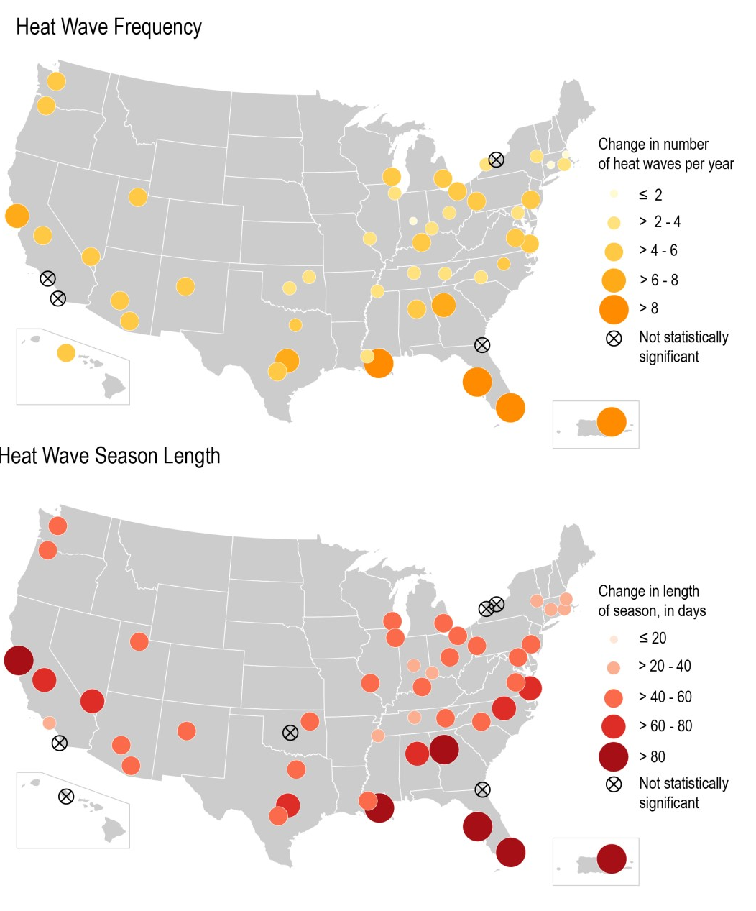
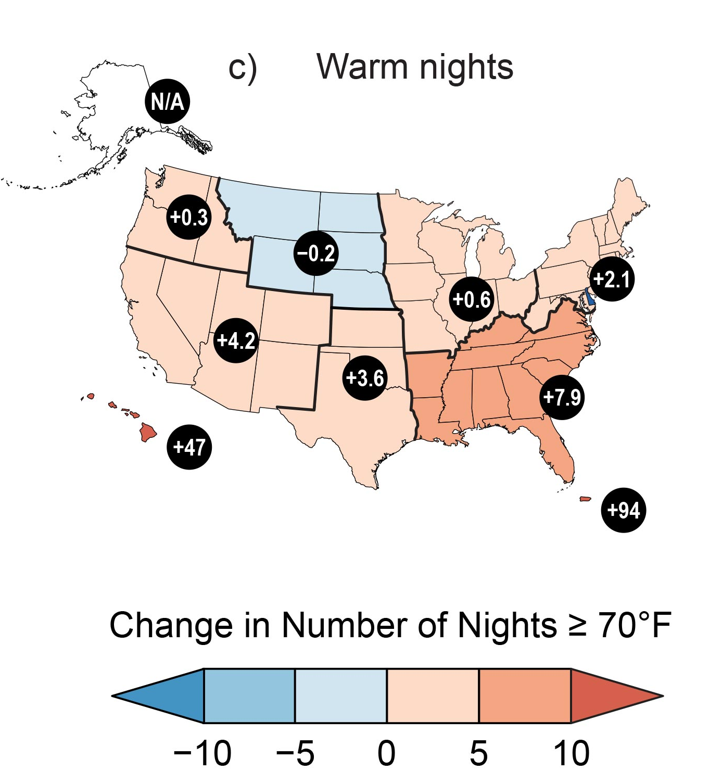
Extreme Heat
Heat wave characteristics in 50 large US cities 1961 – 2021¹
Learning objectives
Attribution science
Effects of climate change
Heat
Precipitation
Drought
Snowfall and ice
Storms
Hurricanes
Sea level rise
Infectious diseases
Carbon sinks
Observed trends:
Heat waves are more frequent, intense, and lasting longer
Warm season is longer
Nighttime temperatures are increasing faster than daytime temperatures
Number of nights with temperatures ≥70°F increasing fastest in humid areas
Observed changes to warm nights between 2001 – 2021 relative to 1901 – 1960²
¹Image copyright U.S. Global Change Research Program. https://www.globalchange.gov/indicators/heat-waves
²Image copyright U.S. Global Change Research Program. https://nca2023.globalchange.gov/chapter/2/
v

Slide 5
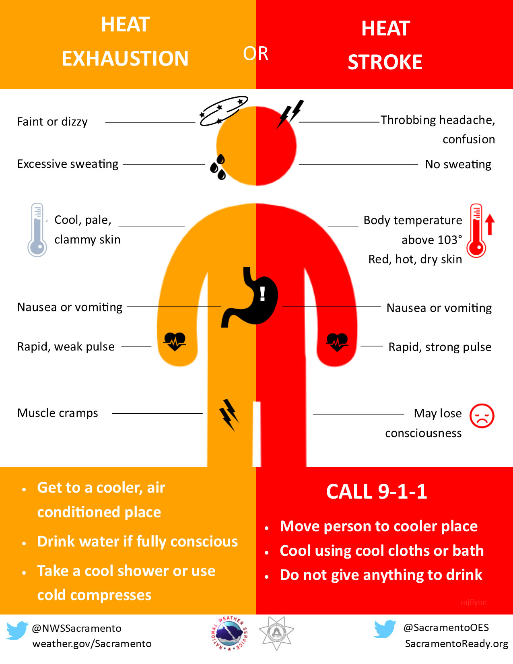
Extreme Heat
Learning objectives
Attribution science
Effects of climate change
Heat
Precipitation
Drought
Snowfall and ice
Storms
Hurricanes
Sea level rise
Infectious diseases
Carbon sinks
Why it matters:
Strengthened urban heat island
Increased heat-related illnesses when:
Humans are unable to cool at night
Humans cannot cool as effectively via sweating in humid areas
Increased heat exposure and illnesses in vulnerable populations
Crop damage, livestock deaths
Heavy demand for air conditioning, power outages
Image copyright National Weather Service. https://www.weather.gov/images/wrn/Infographics/2022/heat-symptoms-2022-final.png
Notes:
Heat-related illnesses:
Time-delayed illnesses!
Sweating, dehydration, thirst
Heat syncope - dizziness, weakness
Heat stroke, exhaustion
Cramps
Rashes
Mental health problems
Rhabdomyolysis – muscle breakdown
Heart problems
Kidney problems

Slide 6
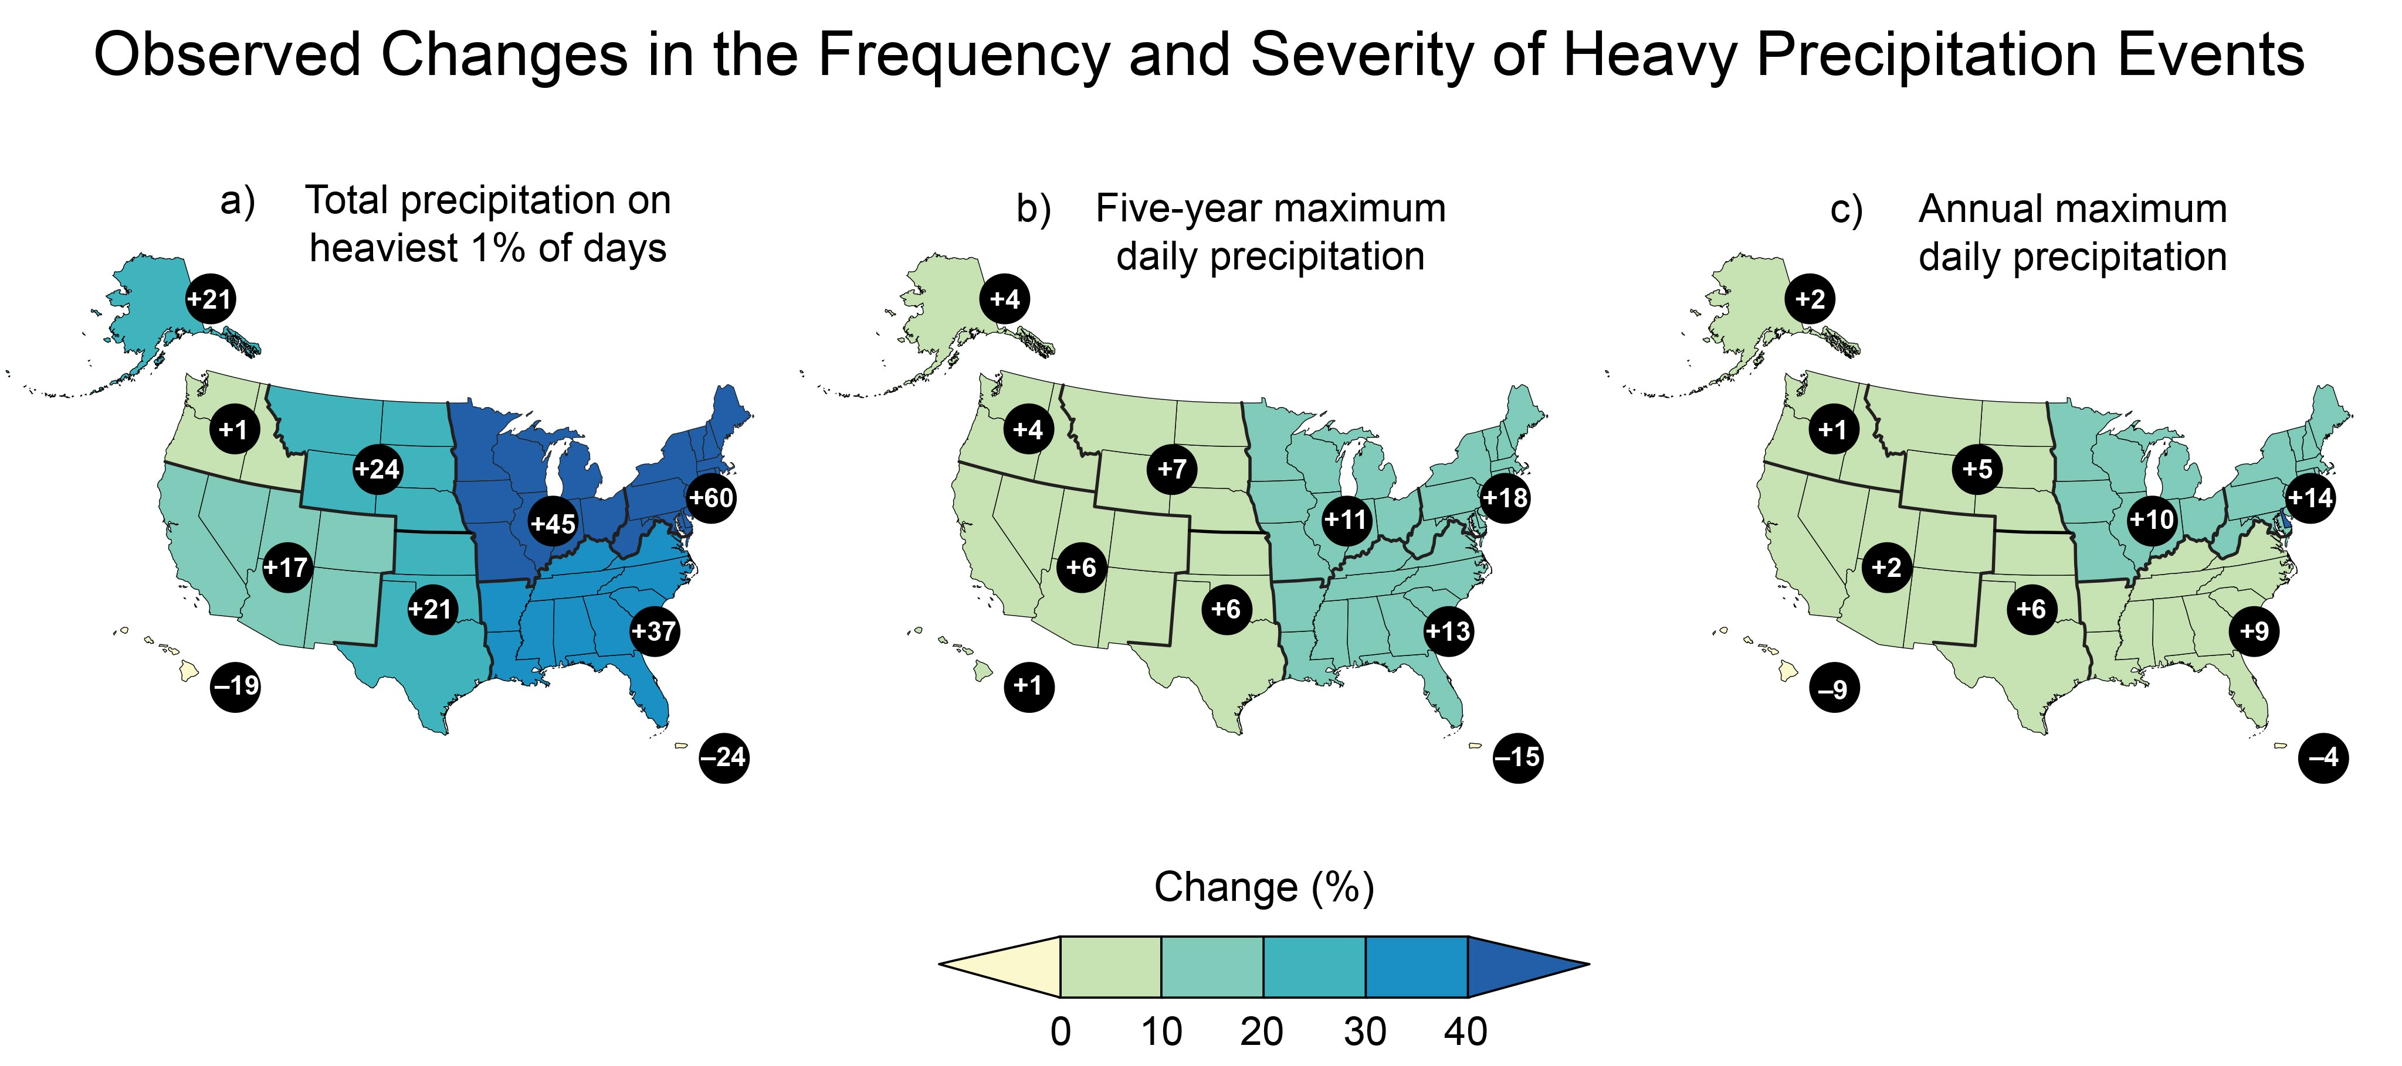
Precipitation
Learning objectives
Attribution science
Effects of climate change
Heat
Precipitation
Drought
Snowfall and ice
Storms
Hurricanes
Sea level rise
Infectious diseases
Carbon sinks
Observed trends:
Warmer temperatures cause more evaporation, resulting in more precipitation
Warmer air holds more moisture
Low-intensity rain days are decreasing
Frequency of heavy precipitation days is increasing
Intensity of each precipitation event is increasing
Why it matters:
Increased river and stream flooding
Increased flash flooding, especially in urban areas
Decreased water quality from runoff
Stormwater systems overwhelmed
Increased risk for geological events, such as landslides
Image copyright U.S. Global Change Research Program. https://nca2023.globalchange.gov/chapter/2/

Slide 7
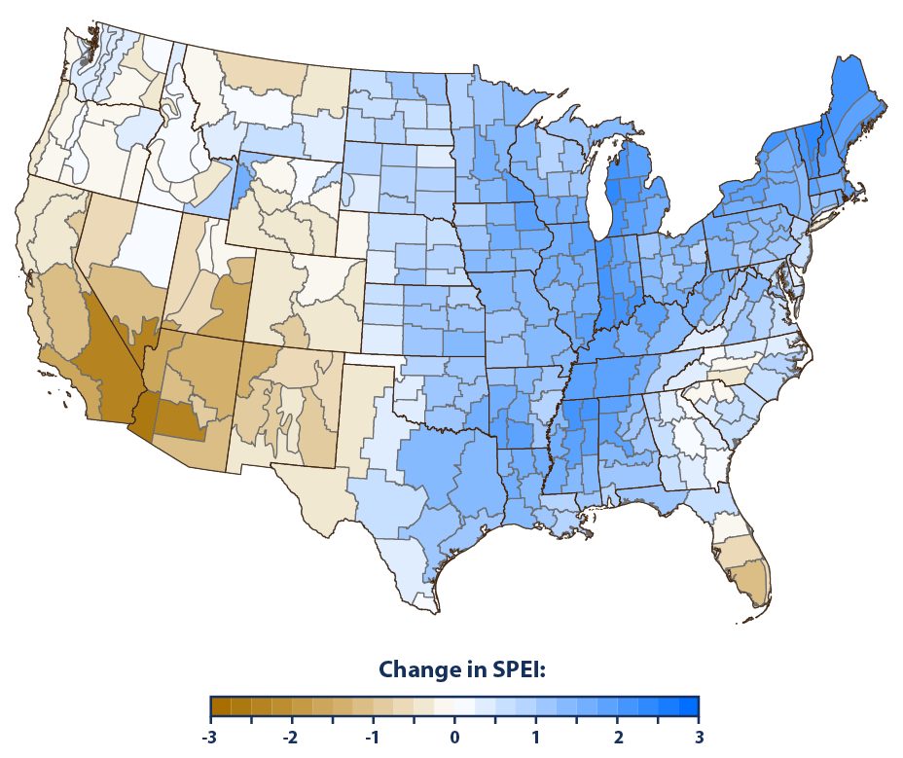
Drought
Learning objectives
Attribution science
Effects of climate change
Heat
Precipitation
Drought
Snowfall and ice
Storms
Hurricanes
Sea level rise
Infectious diseases
Carbon sinks
Observed trends:
Increased warmth associated with increased evapotranspiration
Trends vary by region:
Western U.S. – lower snowfall, higher evaporation leading to more droughts
Southwest U.S. – lower soil moisture, long-term aridification
Eastern U.S. – less frequent droughts from increased precipitation and humidity
Why it matters:
Decreased water availability for humans, crops, livestock, vegetation
Saltwater intrusion
Damage to ecosystems
Change in drought based on long term 5-year average of Standardized Precipitation Evapotranspiration Index (SPEI) from 1900 - 2020
Drier Conditions Wetter Conditions
Image copyright Environmental Protection Agency (EPA). https://www.epa.gov/climate-indicators/climate-change-indicators-drought

Slide 8
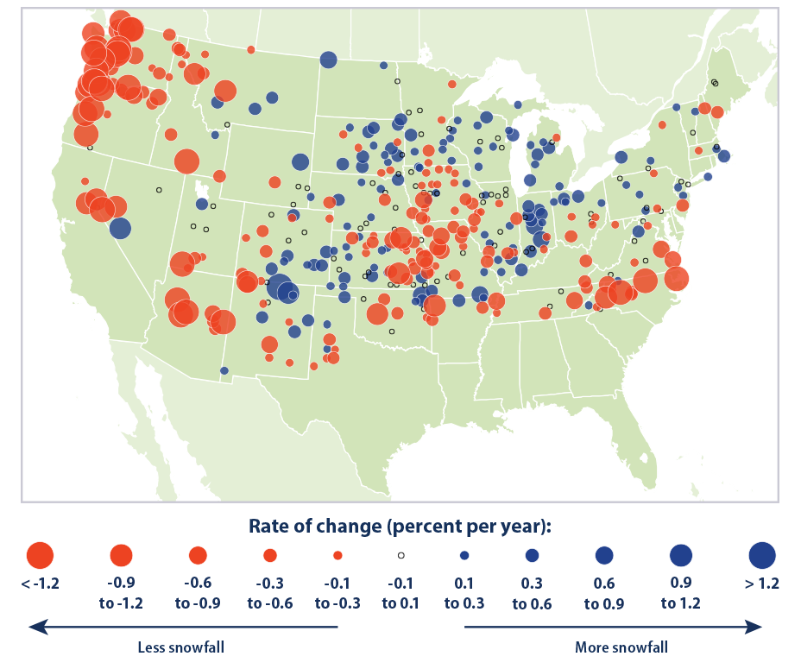
Snowfall and Ice
Learning objectives
Attribution science
Effects of climate change
Heat
Precipitation
Drought
Snowfall and ice
Storms
Hurricanes
Sea level rise
Infectious diseases
Carbon sinks
Observed trends:
Warmer temperatures resulting in more precipitation falling as rain
Trends vary by region:
Pacific Northwest and Midwest – decrease in total snowfall
Great Lakes area – moderate increase in snow
Why it matters:
Snowpack provides water during spring melt, especially in arid areas
Image copyright Environmental Protection Agency (EPA). https://www.epa.gov/sites/default/files/2016-07/snowfall-download1-2016.png

Slide 9
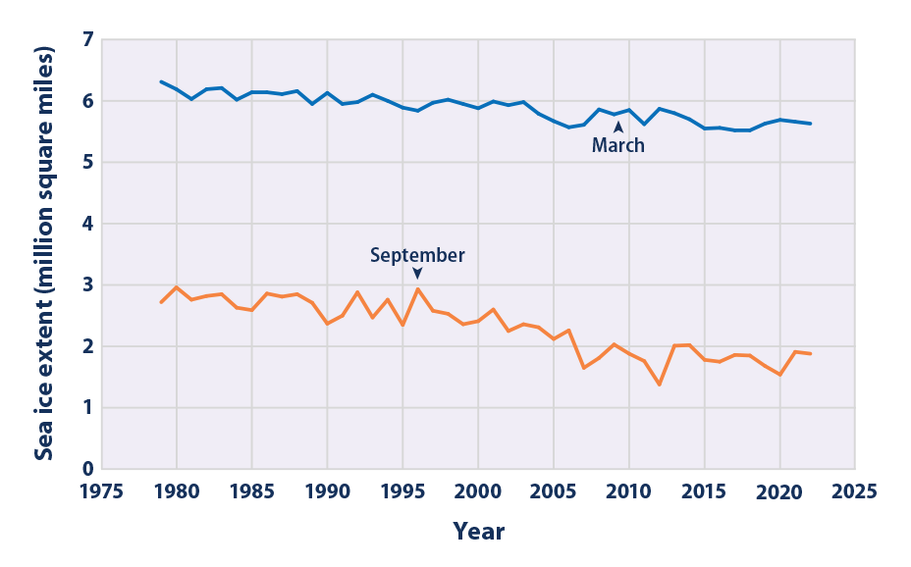
Snowfall and Ice
Learning objectives
Attribution science
Effects of climate change
Heat
Precipitation
Drought
Snowfall and ice
Storms
Hurricanes
Sea level rise
Infectious diseases
Carbon sinks
Observed trends:
Arctic and Antarctic warming the fastest
Melting season is longer
Loss of ice and snow is causing decreased albedo, increasing energy absorption and rate of warming
Why it matters:
Effects hunting, breeding, migration of wildlife
Restricts subsistence hunting in Indigenous Arctic populations
Effects overall energy balance of the Earth
Arctic Sea Ice Extent 1979 – 2022
Image copyright Environmental Protection Agency (EPA). https://www.epa.gov/climate-indicators/climate-change-indicators-arctic-sea-ice
Notes:
Energy balance – with such a large area of high albedo changes so drastically, a great amount of energy is being absorbed and incorporated into the earth’s energy system.

Slide 10
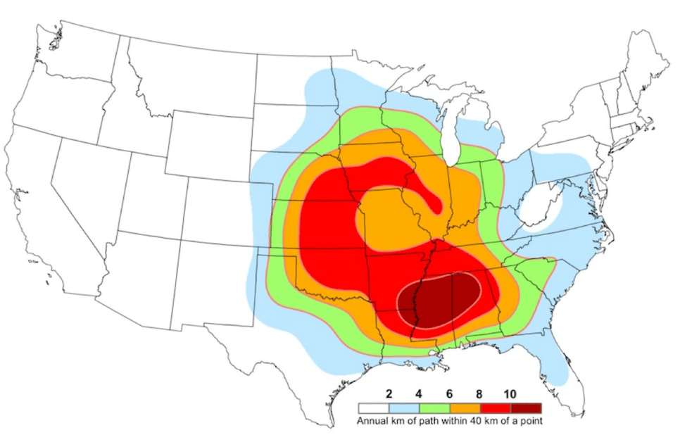
Storms
Learning objectives
Attribution science
Effects of climate change
Heat
Precipitation
Drought
Snowfall and ice
Storms
Hurricanes
Sea level rise
Infectious diseases
Carbon sinks
Observed trends:
Number of storms and tornadoes relatively the same
More outbreaks of storms
More tornadoes outside of the springtime
Stronger tornadoes
Tornado Alley is moving east
No observable trend in lightning
Tornado Alley
1950 – 1984
Tornado Alley
1985 – present
Why it matters:
Increased extreme cold events, resulting in stress on the electrical grids
Increased flooding and debris flows
Changing patterns in storms means new adaptation and mitigation measures are needed
Image copyright P. Grady Dixon, Fort Hayes State University. https://survive-a-storm.com/blog/modern-tornado-alley/

Slide 11
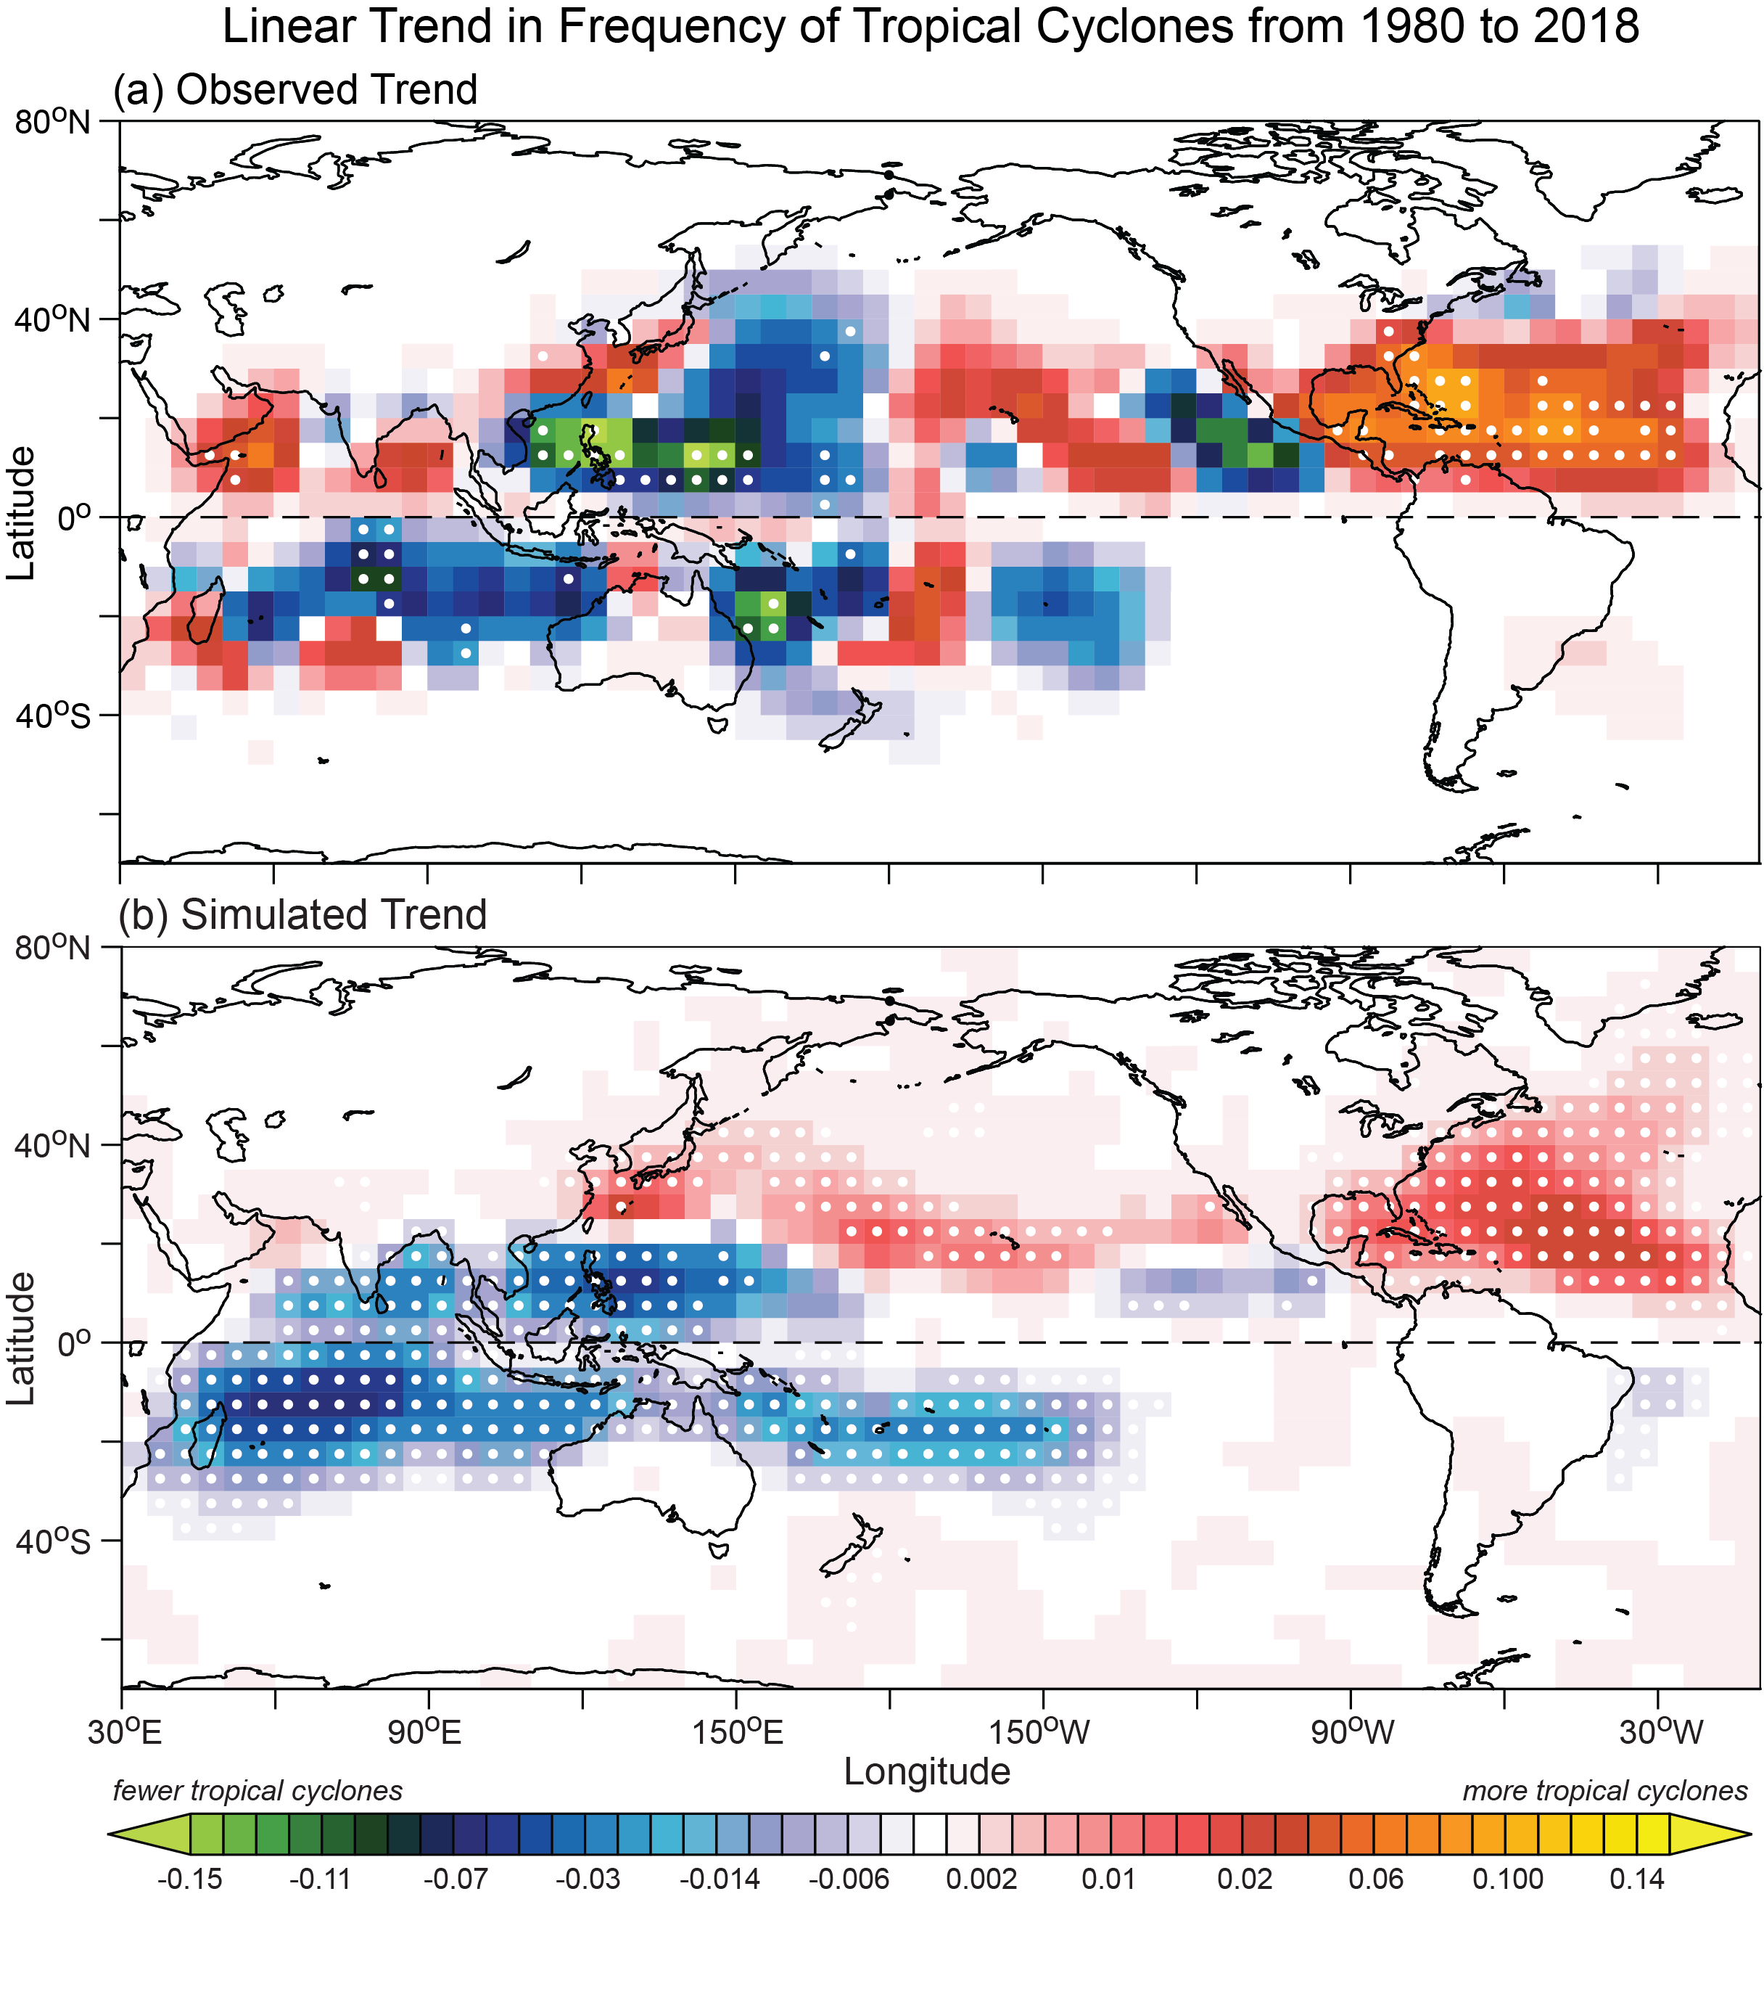
Hurricanes
Attribution science
Effects of climate change
Heat
Precipitation
Drought
Snowfall and ice
Storms
Hurricanes
Sea level rise
Infectious diseases
Carbon sinks
Observed trends:
Increase in frequency of hurricanes in the North Atlantic
No observable trend in frequency of landfalling hurricanes
Hurricanes are intensifying more rapidly, moving more slowly, and moving poleward
Why it matters:
Less time to prepare for effects of intense hurricanes increases vulnerability
Affected locations receive increased wind damage, rainfall, flooding, and height of storm surge
Image copyright NOAA Geophysical Fluid Dynamics Laboratory. https://www.gfdl.noaa.gov/global-warming-and-hurricanes/

Slide 12
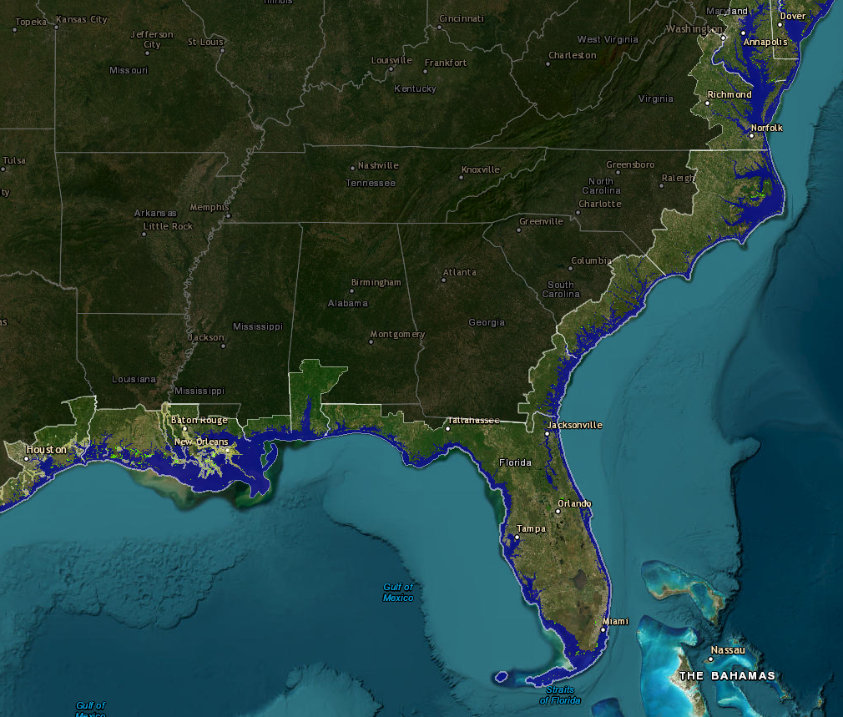
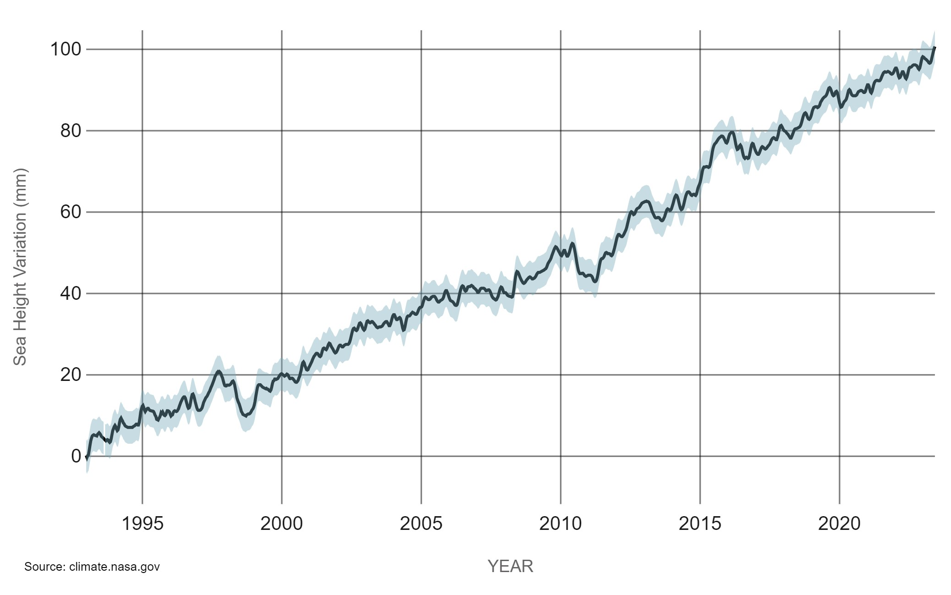
Sea Level Rise
Learning objectives
Attribution science
Effects of climate change
Heat
Precipitation
Drought
Snowfall and ice
Storms
Hurricanes
Sea level rise
Infectious diseases
Carbon sinks
Observed trends:
Global average sea level has increased 8–9” since 1880 from ice melt and thermal expansion of the ocean
Rate at which sea level is rising is increasing
Coastal areas with erosion, oil extraction, groundwater pumping have a greater rise
Why it matters:
Increased flooding, shoreline erosion
More intense hazards from hurricanes
Negative effects on infrastructure
Current areas experiencing inundation from sea level rise²
Sea Level Rise 1993 – Present¹
¹Image copyright NASA’s Goddard Space Flight Center. https://climate.nasa.gov/vital-signs/sea-level/
²Image copyright NOAA’s Office for Coastal Management. https://coast.noaa.gov/slr/

Slide 13
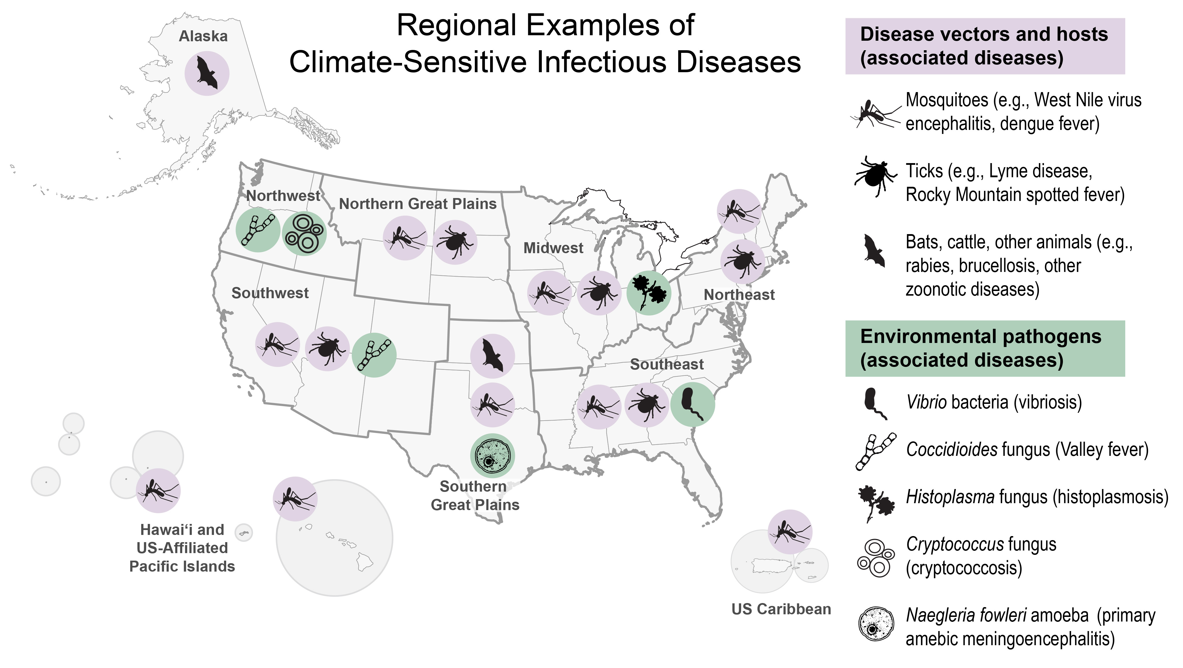
Infectious Diseases
Learning objectives
Attribution science
Effects of climate change
Heat
Precipitation
Drought
Snowfall and ice
Storms
Hurricanes
Sea level rise
Infectious diseases
Carbon sinks
Observed trends:
Infectious diseases, such as West Nile, meningoencephalitis, valley fever, and Lyme, becoming more common
Ranges expanding as climate warms and creates new habitats for vectors
Vector seasons lengthening
Why it matters:
Threats to human health and other vulnerable species
Increase morbidity and mortality
Image copyright U.S. Global Change Research Program. https://nca2023.globalchange.gov/chapter/15/

Slide 14
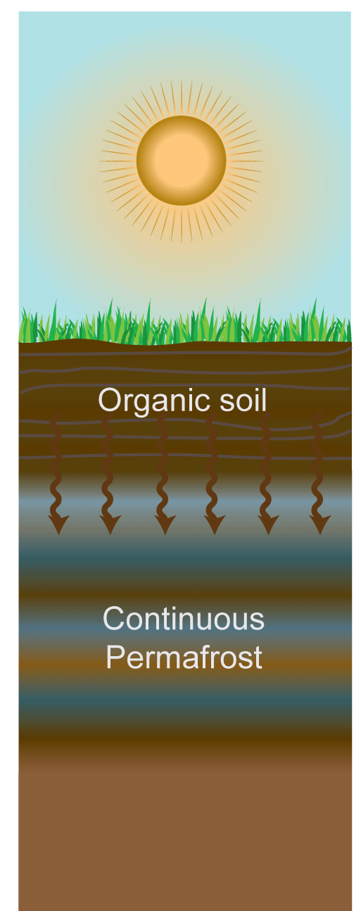
Carbon Sinks
Learning objectives
Attribution science
Effects of climate change
Heat
Precipitation
Drought
Snowfall and ice
Storms
Hurricanes
Sea level rise
Infectious diseases
Carbon sinks
Greenhouse gases released into atmosphere
Observed trends:
Warmer oceans hold less CO₂
Land cover change that results in removing and altering the biosphere leads to less CO₂ stored in vegetation
Melting of permafrost releases stored greenhouse gases
Why it matters:
Reduced carbon sinks result in increased greenhouse gases in the atmosphere and increased global warming
Surface temperature increases
Organic soil deepens
Permafrost carbon thaws and decays
Image modified from United Nations Environment Programme, Global Environmental Alert Service. https://na.unep.net/geas/newsletter/Mar_11.html

Slide 15
How is climate change affecting the Earth and human health?
Learning objectives
Attribution science
Effects of climate change
Heat
Precipitation
Drought
Snowfall and ice
Storms
Hurricanes
Sea level rise
Infectious diseases
Carbon sinks
Increasing thermal stress, especially for vulnerable persons in urban microclimates
Precipitation, storms, and tornadoes are occurring in more “clumped” patterns
Hurricanes are moving slower, becoming more intense, and moving poleward
Sea level rise is inundating coastal areas and worsening hazards from hurricanes
Many types of infectious diseases are moving into areas that previously did not experience them
Carbon sinks are outgassing CO₂ and taking in less than previously

Slide 16
Discussion Prompts
Provide at least two examples each of extreme events that scientists can and cannot confidently attribute to climate change.
How have heat waves, warm seasons, and nighttime temperatures changed since 1901?
What is the impact of climate change on both individuals and society?
Describe the trends in each of the following: precipitation, drought, snowfall, ice, storms, hurricanes, sea level, infectious diseases, and carbon sinks.
Reflect on the effects of climate change on the different socioeconomic groups in your community.

